Slide 1
Studying Box Office Trends in China and Japan
Patrick Shan
Springboard Capstone I
June 7, 2019

Slide 2
Background
Increased interest in foreign box office of China and Japan
Film industries in countries appear to be increasing since 2012
In contrast, domestic box office grosses become more inconsistent
Unclear what factors drive box office growth in these countries

Slide 3
Potential Clients
Film Industry: identify business strategies are more likely associated with box office growth (i.e. investing in multiplexes, reaching out to a wider audience)
Investors: figure out which markets show the most consistent growth
Marketing Firms: determine the consumer trends and identify the best advertising methods

Slide 4
Data Wrangling
Data Sources
Film Industry in China and Japan from Kaggle
China Average Income from OECD
Japan Average Income from Bureau of Statistics
World Population from Global Social Change
Big Mac Index from the Economist
Data Wrangling
Monetary values in China and Japan dataset scaled using Purchasing power parity (PPP) from Big Mac Index
Combined data sources into singular CSV file

Slide 5
Data Wrangling (Cont.)
Dataset was loaded in Python 3 of Jupyter Notebook
Methods
Matplotlib and Seaborn graphing
Line graphs for returns over time
Bar graphs for directly comparing countries
Color-mapping graphs for correlating factors

Slide 6
Main Variables for Each Country
Independent Variables
Dependent Variable
Tickets Sold
Ticket Price
Number of Screens
Number of New Movies
Average Wage
Tickets Sold per 100,000 people
Gross per Capita
Box Office Gross

Slide 7
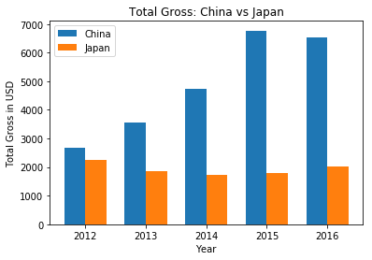
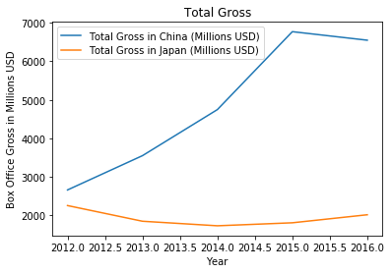
Comparing Total Grosses
China’s grosses increase while Japan’s remain static
Gap between countries’ grosses increase over time
Suggests that Japan’s film industry isn’t growing

Slide 8
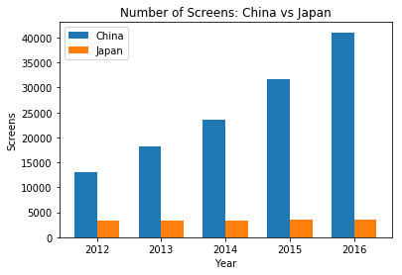
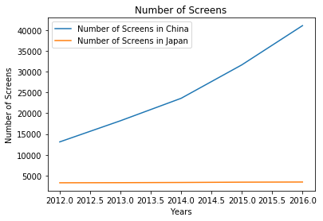
Comparing Number of Screens
China is adding new screens whereas Japan isn’t
Gap between countries’ in screens increasing over time

Slide 9
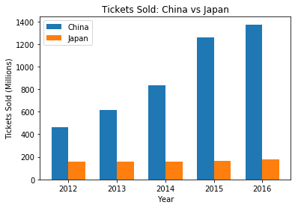
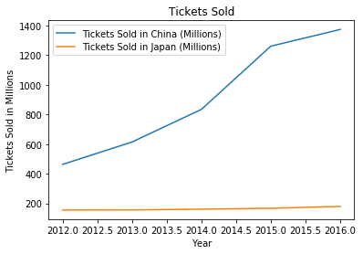
Comparing Number of Tickets Sold
China experiences growth in ticket sales while Japan experiences stagnation
Implies that more people are going to theaters in China

Slide 10
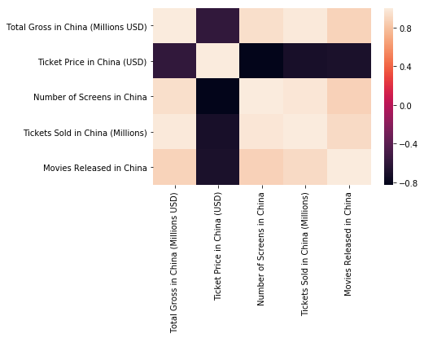
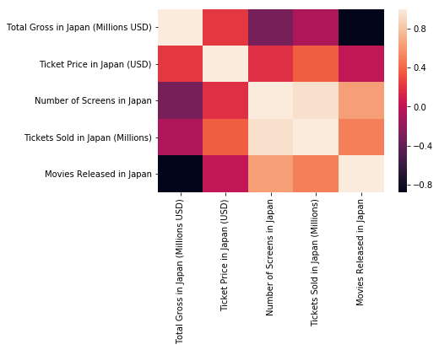
Correlation Color Map

Slide 11
Inferential Statistics
Independent T-Test
Compares the countries’ variables to determine if there is a statistically significant difference between them
Test chosen because of its flexibility with smaller data sets
Pearson Correlation
Compares correlations between variables and total grosses for each country
Determine which variables affect total gross

Slide 12
Independent T-Test Between Countries
Parameters | T-Statistic | P-Value
Grosses | 3.594 | 0.007
Tickets Sold | 4.196 | 0.003
Tickets Sold per Hundred Thousand People | -4.678 | 0.002
Screens | 4.474 | 0.002
Ticket Price | -24.120 | 0.000
New Movies Released | -13.231 | 0.000

Slide 13
Pearson Correlation
Parameter | Box Office Variable | Coefficient | P-Value
Tickets Sold in China | Total Gross in China | 0.986 | 0.002
Tickets Sold per Hundred Thousand People in China | Total Gross in China | 0.987 | 0.002
Screens in China | Total Gross in China | 0.937 | 0.019
Ticket Price in China | Total Gross in China | -0.587 | 0.298
New Movies Released in China | Total Gross in China | 0.885 | 0.046
Tickets Sold in Japan | Total Gross in Japan | -0.077 | 0.902
Tickets Sold per Hundred Thousand People in Japan | Total Gross in Japan | -0.076 | 0.903
Screens in Japan | Total Gross in Japan | -0.310 | 0.612
Ticket Price in Japan | Total Gross in Japan | 0.219 | 0.723
New Movies Released in Japan | Total Gross in Japan | 0.877 | 0.051

Slide 14
Machine Learning
Linear regression test
Great for time-series data
Predicts correlation between variables
Numerical outcomes represented by R² and Root Mean Square Error (RMSE)
R² value closer to 1 indicates tighter fit of regression
Smaller RMSE value indicates more reliable prediction

Slide 15
Linear Regression and R² Results
Aggregate Country Data | R-Squared Value | RMSE
China | 0.296 | 1258.38
Japan | -4.064 | 4626.96
China's box office:
Total Gross = 1.5468 x Tickets Sold (Millions) + 0.1453 x Number of Screens - 0.0009 x Ticket Price (USD) + 1.4862 Movies Released - 549.2727
Japan's box office:
Total Gross = -0.0420 x Tickets Sold (Millions) - 0.5222 x Number of Screens + 0.0049 x Ticket Price (USD) + -2.4207 Movies Released in Japan - 6356.8774

Slide 16
Project Summary
The visualization shows that not only is China outpacing Japan in grosses and most box office parameters, but that the disparities between each country has been increasing over time.
Inferential Statistics shows that the parameter values between China and Japan are significantly different. Furthermore, the number of tickets sold, screens, and new releases positively correlate with China’s gross. In contrast, Japan’s gross positively correlates with ticket prices
The machine learning with linear regression supports many of the assumptions from Inferential Statistics. However, the results from Japan are questionable to a degree.

Slide 17
Conclusion
The China’s film industry appears to be growing with all parameters increasing over time. Conversely, Japan’s film industry appears to be stagnating in regards to all metrics.
China’s box office correlates with increased ticket sales, screens, and new releases. This implies that the growth is driven by attendance and not ticket pricing.
Japan’s box office correlates only with increased ticket prices. This implies that any growth is caused by pricing and not increased attendance.

Slide 18
Limitations
Small dataset size
Not enough samples for 5-fold cross-validation
Limited scope makes it more difficult to carry out other types of machine learning
Missing information
Film audience demographics
Exact size of film audience
Genre composition of films

Slide 19
Future Directions
Find larger sets with more years
Larger size allows more reliable testing
Larger size is more flexible with other forms of testing like naive Bayes, decision trees, and k-nearest neighbors
Additional parameters
Movie genres
Audience demographics
Local vs. foreign movies

Slide 20
Recommendations
The gross and number of tickets sold have been increasing in China but are static in Japan. This indicates that China’s is the only one showing growth and would therefore be a more financially lucrative for the foreseeable future.
China’s box office grosses increases alongside number of tickets sold, number of screens, and number of new movies. As such, this seems to suggest that greater film attendance would lead to increased revenue as opposed to increased ticket prices. To capitalize on this trend, the industry should invest in additional theaters and market to a wide audience.
Japan’s box office grosses increases only in conjunction with ticket price. This would imply that the growth is driven by rising ticket prices and a niche audience rather than increased attendance. This means that the industry should focus on raising ticket prices, marketing towards niche audiences, and offering premium services.

